Slide 1
Types of Data/ Data Characteristic

Slide 2
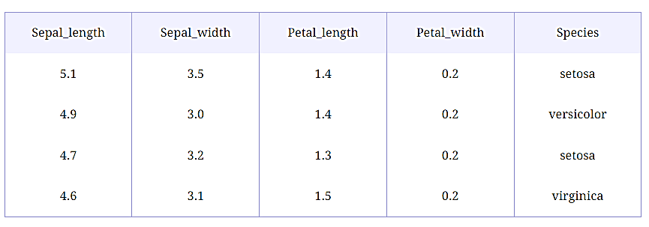
Structured vs. Semi-Structured vs. Unstructured Data
Structured Data
It comes with a predefined format and structure. Structured Data is usually stored in Relational Databases. It is easy to deal with in the Data Science domain.

Slide 3
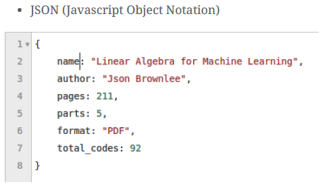
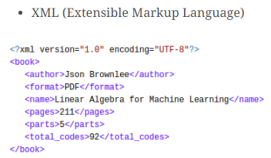
Semi-Structured Data
It comes with a predefined format and structure but is not stored in the Relational Database.

Slide 4
Unstructured Data
It does not have a specific format and lacks structure. It is the type of data that presents many challenges to handle in the Data Science domain
Examples:
Images
Videos
Speech

Slide 5
describe the dataset
Need to know in what form the data is present to analyze it properly and apply different statistical methods on it
What do your records represent?
What does each attribute mean?
What type of attributes?
Categorical
Numerical

Slide 6
Data Types

Slide 7
Categorical data
Categorical data as the name suggests, represent categories or characteristics such as gender, language, level of education, marital status, the genre of a movie, etc
It is also known as Qualitative Data.
We can associate numerical values with categorical data, but they would not have any mathematical meaning, e.g., 0/1 for male/female.

Slide 8
Categorical data 1. Nominal data
Nominal data is categorical data that has no order
It can be thought of as labels, have no quantitative value
Gender of a person as male or female
Language a person speaks
Eye color
Nominal Data can be dealt with using frequencies, proportions, pie charts, bar plots, etc.

Slide 9
Categorical data 2. Ordinal data
Ordinal data is categorical data that has a sense of order to it
Ordinal values represent discrete and ordered units
It is therefore nearly the same as nominal data, except that it’s ordering matters
Happiness level of a customer
Level of education (Higher, Secondary, Primary)
Rating of a movie on a scale of 0−5
Height in {tall, medium,short}
rRnkings (e.g. Taste of potato chips on scale from 1-10)
Letter grades in exam (A,B,C,D etc.)
We can summarize ordinal data with frequencies, median, mean, etc. For visualization, we can use pie charts and bar charts.

Slide 10
Categorical data 3. Binary
Special type of categorical data called binary
Binary data types only have two values – yes or no.
This can be represented in different ways such as “True” and “False” or 1 and 0
Binary data is used heavily for classification machine learning models.

Slide 11
Data Types

Slide 12
Numerical /Quantitative data
Expressed as a number, so it can be quantified
Represents the numerical value integer or real values
Height of a person
Price of a product
Number of students in class
Number of lessons in this course
Discrete data
Continuous data
Notes:
Numerical /Quantitative data:
(how much, how many, how often)

Slide 13
Numerical Data 1. Discrete data
Has only a finite or countably infinite set of values
Data is discrete if the values of data are distinct and separate
Data can only take on certain values
This type of data can’t be measured but it can be counted
Zip codes
Set of words in a collection of documents
Number of heads in 100 tosses of a coin flip
Number of students in a classroom
Number of cars in a showroom
Often represented as integer variables
We can use statistical methods such as mean, median, Box plots, and Histograms to describe numerical data.

Slide 14
Numerical /Quantitative data (Cont.) 2. Continuous data
Continuous data cannot be counted, but it can be measured, It represents measurements
Market share Price (Money)
Height/weight of a person
Speed of a car
Wi-Fi Frequency
It can be divided into further meaningful parts

Slide 15
Continuous data 1. Interval Data
The data can be categorized and ranked and evenly spaced
Interval-scaled attributes are measured on a scale of equal-size units
The values of interval-scaled attributes have order and can be positive, 0, or negative.
Thus, in addition to providing a ranking of values, such attributes allow us to compare and quantify the difference between values
temperatures in celcius or Fahrenheit
calendar dates, the years 2002 and 2010 are eight years apart

Slide 16
Continuous data 2. Ratio data
A ratio-scaled attribute is a numeric attribute with an essential zero-point.
That is, if a measurement is ratio-scaled, we can speak of a value as being a multiple (or ratio) of another value
In addition, the values are ordered, and we can also compute the difference between values
Other examples of ratio-scaled attributes include count attributes such as years of experience (e.g., the objects are employees) and measuring tape starting at true zero,

Slide 17
Properties of attribute values:
The type of an attribute depends on which of the following properties it possesses:
Distinctness: = 
Order: < >
Addition: + -
Multiplication: * /
Nominal attribute: distinctness
Ordinal attribute: distinctness & order
Interval attribute: distinctness, order & addition
Ratio attribute: all 4 properties

Slide 18
Properties of attribute values:
Nominal Attribute:
Distinctness: Nominal data are categories that are distinct from each other but do not have any inherent order or numerical meaning.
Addition & Multiplication: Not Applicable. You cannot perform addition or multiplication on nominal data because they are purely categorical with no numerical value or order. For example, you can't add "Red" + "Blue" or multiply "Apple" × "Banana."

Slide 19
Properties of attribute values:
Ordinal Attribute:
Distinctness & Order: Ordinal data have a clear order, but the intervals between the categories are not consistent or meaningful.
Addition & Multiplication: Not Applicable. While ordinal data have order, you cannot meaningfully add or multiply these values because the differences between categories are not uniform. For example, the difference between "Neutral" and "Satisfied" is not necessarily the same as between "Satisfied" and "Very Satisfied," so operations like addition or multiplication are not appropriate.

Slide 20
Properties of attribute values:
Interval Attribute:
Distinctness, Order & Addition: Interval data have meaningful order, and the intervals between values are consistent.
Addition: Applicable. You can say that the difference between 2:00 PM and 4:00 PM is 2 hours, just as the difference between 4:00 PM and 6:00 PM is also 2 hours.

Slide 21
Properties of attribute values:
Ratio Attribute:
Distinctness, Order, Addition & Multiplication: Ratio data have all the properties of interval data but also include a true zero point
Addition: Applicable. Like interval data, you can add and subtract ratio data meaningfully. For example, 50 kg + 20 kg = 70 kg.
Multiplication: Applicable. Ratio data have a true zero, so multiplication is meaningful. For example, if you weigh 60 kg, and someone weighs 30 kg, you can say that you are "twice as heavy" as that person because 0 kg represents no weight at all.

Slide 22
Activity
Attribute | Example Values
Blood Type | A, B, AB, O
Movie Rating | 1 star, 2 stars, 3 stars, 4 stars, 5 stars
Temperature (°C) | 10°C, 20°C, 30°C
Height (cm) | 150 cm, 160 cm, 170 cm
ZIP Code | 10001, 90210, 30301
Education Level | High School, Bachelor’s, Master’s, Ph.D.
Year of Birth | 1990, 2000, 2010
Weight (kg) | 50 kg, 75 kg, 100 kg
Phone Number | 555-1234, 555-5678, 555-9876
Military Rank | Colonel, Major, Captain
Time of Day (24hr) | 12:00, 14:30, 18:00
Distance (km) | 5 km, 10 km, 20 km

Slide 23
Activity
Attribute | Example Values
Eye Color | Blue, Green, Brown, Hazel
Pain Scale (0-10) | 0, 3, 7, 10
IQ Score | 90, 100, 110, 120
Income ($) | $30,000, $50,000, $70,000
Social Security Number | 123-45-6789, 987-65-4321
Satisfaction Rating | Very Dissatisfied, Neutral, Very Satisfied
Calendar Year | 2015, 2020, 2025
Age (years) | 25, 40, 60
Vehicle License Plate | ABC-1234, XYZ-5678
Customer Loyalty Level | Bronze, Silver, Gold
Date (MM/DD/YYYY) | 01/15/2022, 12/31/2023
Weight of a Backpack (kg) | 2 kg, 4 kg, 6 kg

Slide 24
Solution
Attribute | Type | Properties | Example Values
Blood Type | Nominal | Distinctness | A, B, AB, O
Movie Rating | Ordinal | Distinctness, Order | 1 star, 2 stars, 3 stars, 4 stars, 5 stars
Temperature (°C) | Interval | Distinctness, Order, Addition | 10°C, 20°C, 30°C
Height (cm) | Ratio | Distinctness, Order, Addition, Multiplication | 150 cm, 160 cm, 170 cm
ZIP Code | Nominal | Distinctness | 10001, 90210, 30301
Education Level | Ordinal | Distinctness, Order | High School, Bachelor’s, Master’s, Ph.D.
Year of Birth | Interval | Distinctness, Order, Addition | 1990, 2000, 2010
Weight (kg) | Ratio | Distinctness, Order, Addition, Multiplication | 50 kg, 75 kg, 100 kg
Phone Number | Nominal | Distinctness | 555-1234, 555-5678, 555-9876
Military Rank | Ordinal | Distinctness, Order | Private, Sergeant, Captain
Time of Day (24hr) | Interval | Distinctness, Order, Addition | 12:00, 14:30, 18:00
Distance (km) | Ratio | Distinctness, Order, Addition, Multiplication | 5 km, 10 km, 20 km

Slide 25
Attribute | Type | Properties | Example Values
Eye Color | Nominal | Distinctness | Blue, Green, Brown, Hazel
Pain Scale (0-10) | Ordinal | Distinctness, Order | 0, 3, 7, 10
IQ Score | Interval | Distinctness, Order, Addition | 90, 100, 110, 120
Income ($) | Ratio | Distinctness, Order, Addition, Multiplication | $30,000, $50,000, $70,000
Social Security Number | Nominal | Distinctness | 123-45-6789, 987-65-4321
Satisfaction Rating | Ordinal | Distinctness, Order | Very Dissatisfied, Neutral, Very Satisfied
Calendar Year | Interval | Distinctness, Order, Addition | 2015, 2020, 2025
Age (years) | Ratio | Distinctness, Order, Addition, Multiplication | 25, 40, 60
Vehicle License Plate | Nominal | Distinctness | ABC-1234, XYZ-5678
Customer Loyalty Level | Ordinal | Distinctness, Order | Bronze, Silver, Gold
Date (MM/DD/YYYY) | Interval | Distinctness, Order, Addition | 01/15/2022, 12/31/2023
Weight of a Backpack (kg) | Ratio | Distinctness, Order, Addition, Multiplication | 2 kg, 4 kg, 6 kg

